Slide 1
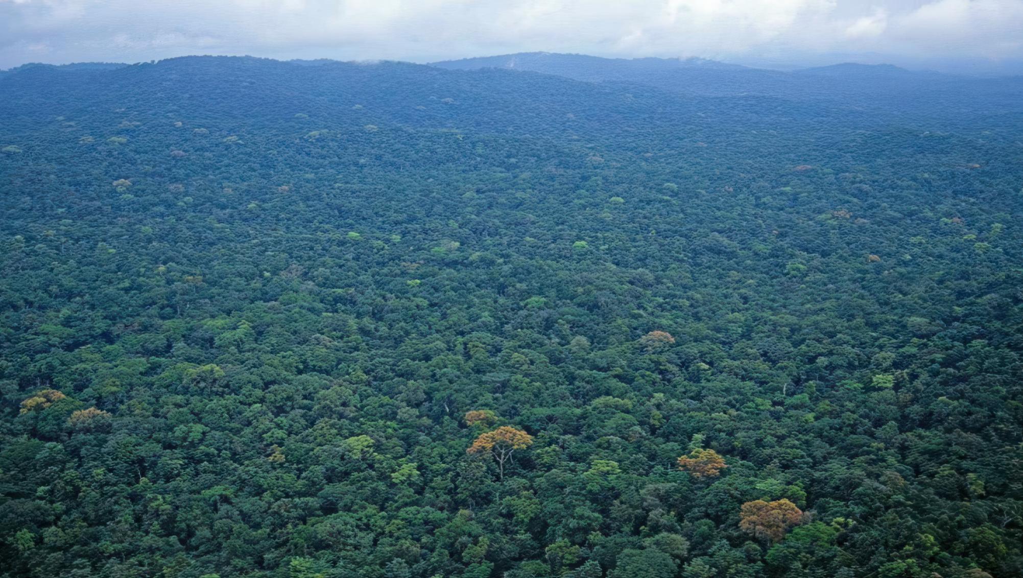
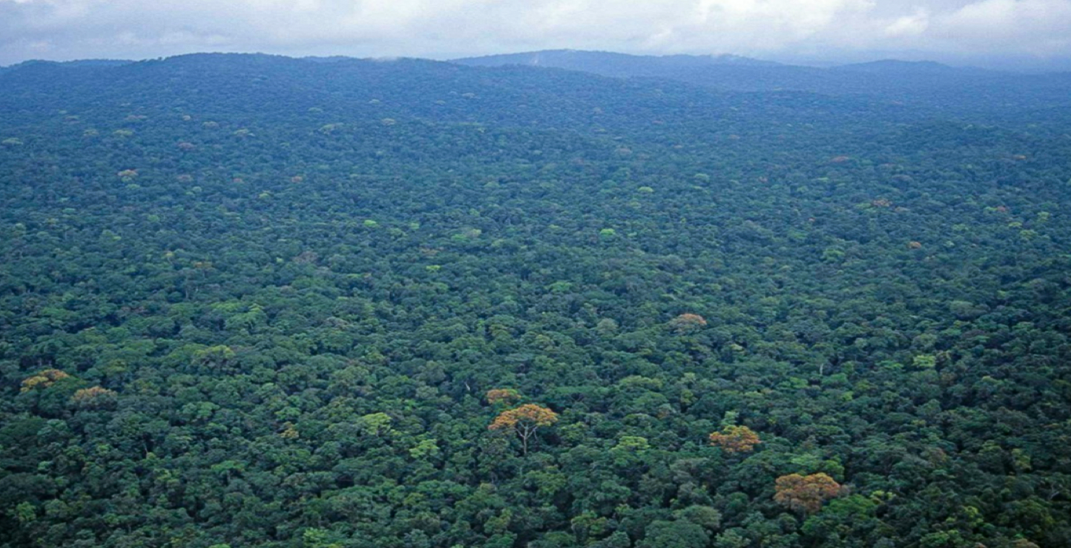


GHANA’S REDD+ PROCESSES;
THE JOURNEY SO FAR
November 3-5, 2025
Presented by:
Thomas Yaw Gyambrah
Manager, MRV & REDD+ Programs

Slide 2


Introduction and Strategic Vision
The REDD+ initiative (Reducing Emissions from Deforestation and Forest Degradation, plus conservation, sustainable management, and enhancement of forest carbon stocks) is Ghana's primary mechanism for leveraging the forest sector in its climate change mitigation strategy.
Ghana’s vision is to significantly reduce emissions from deforestation and forest degradation over the next 20 years, while simultaneously addressing threats to ecosystem services and environmental integrity to maximize co-benefits. This vision is a cornerstone of the forestry sector's contribution to the Paris Agreement (Article 5).

Slide 3
Forest and Forest-Related Policies
1. Paradigm shift from the past policies. Emphasis on non-consumptive values of the forest and creating a balance between timber production and marketing to satisfy particularly domestic wood demands.
2. Provides strategic direction, actions and resources required to promote the development of productive and sustainable forest restoration interventions.
3. Provides a strategic direction and coordinated approach for climate resilience. Includes priorities like disaster risk reduction, resilient infrastructure, and climate-smart agriculture
4. Outlines specific activities and targets for building climate resilience in areas like food security, water resources, and coastal zone management
5. Provide financial intermediation and incentive mechanisms for natural forest
management, timber plantation development, plant and machinery development of tertiary processing activities and micro and small wood processing enterprises
6. Focuses on reducing emissions from deforestation and forest degradation while promoting sustainable forest management, conservation, and carbon stock enhancement.
3
National Climate Change Policy, 2013
4
Ghana National Climate Change Master Plan Action Programmes for Implementation (2015-2020)
5
Forestry Development Master Plan ((2016-2036)
6.
The Ghana REDD+ Strategy 2016
1
The Ghana Forest &
Wildlife Policy, 2012
2
Ghana National Plantation Strategy

Slide 4
Why REDD+ is Important to Ghana
Climate Change Mitigation
The forestry sector is critical, contributing 33% of the country's total emission reduction goal under its Nationally Determined Contributions (NDCs).
Economic Resilience
Protecting forests is like having natural insurance for Ghana’s economy. Since farming (especially cocoa) relies on stable rain and healthy soil, REDD+ ensures these vital natural services continue, helping Ghana’s agriculture survive despite climate change and preventing major economic losses (eg. Cocoa).
Carbon Finance
It is a performance-based mechanism that unlocks carbon finance, providing new revenue streams based on verified results.

Slide 5
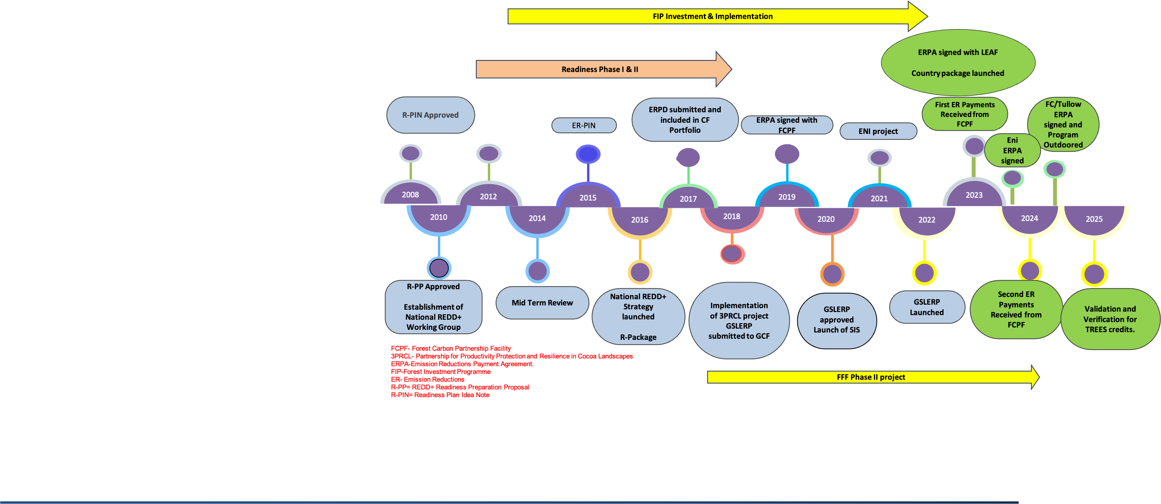
The REDD+ Trajectory
Ghana has successfully moved through the global phases of REDD+:
1. Readiness: Development of key structures (Safeguards, MRV, Benefit Sharing Plans).
2. Piloting: Testing of systems and interventions.
3. Results-Based: Technical assistance and payment for verified Emission Reductions (ERs).

Slide 6
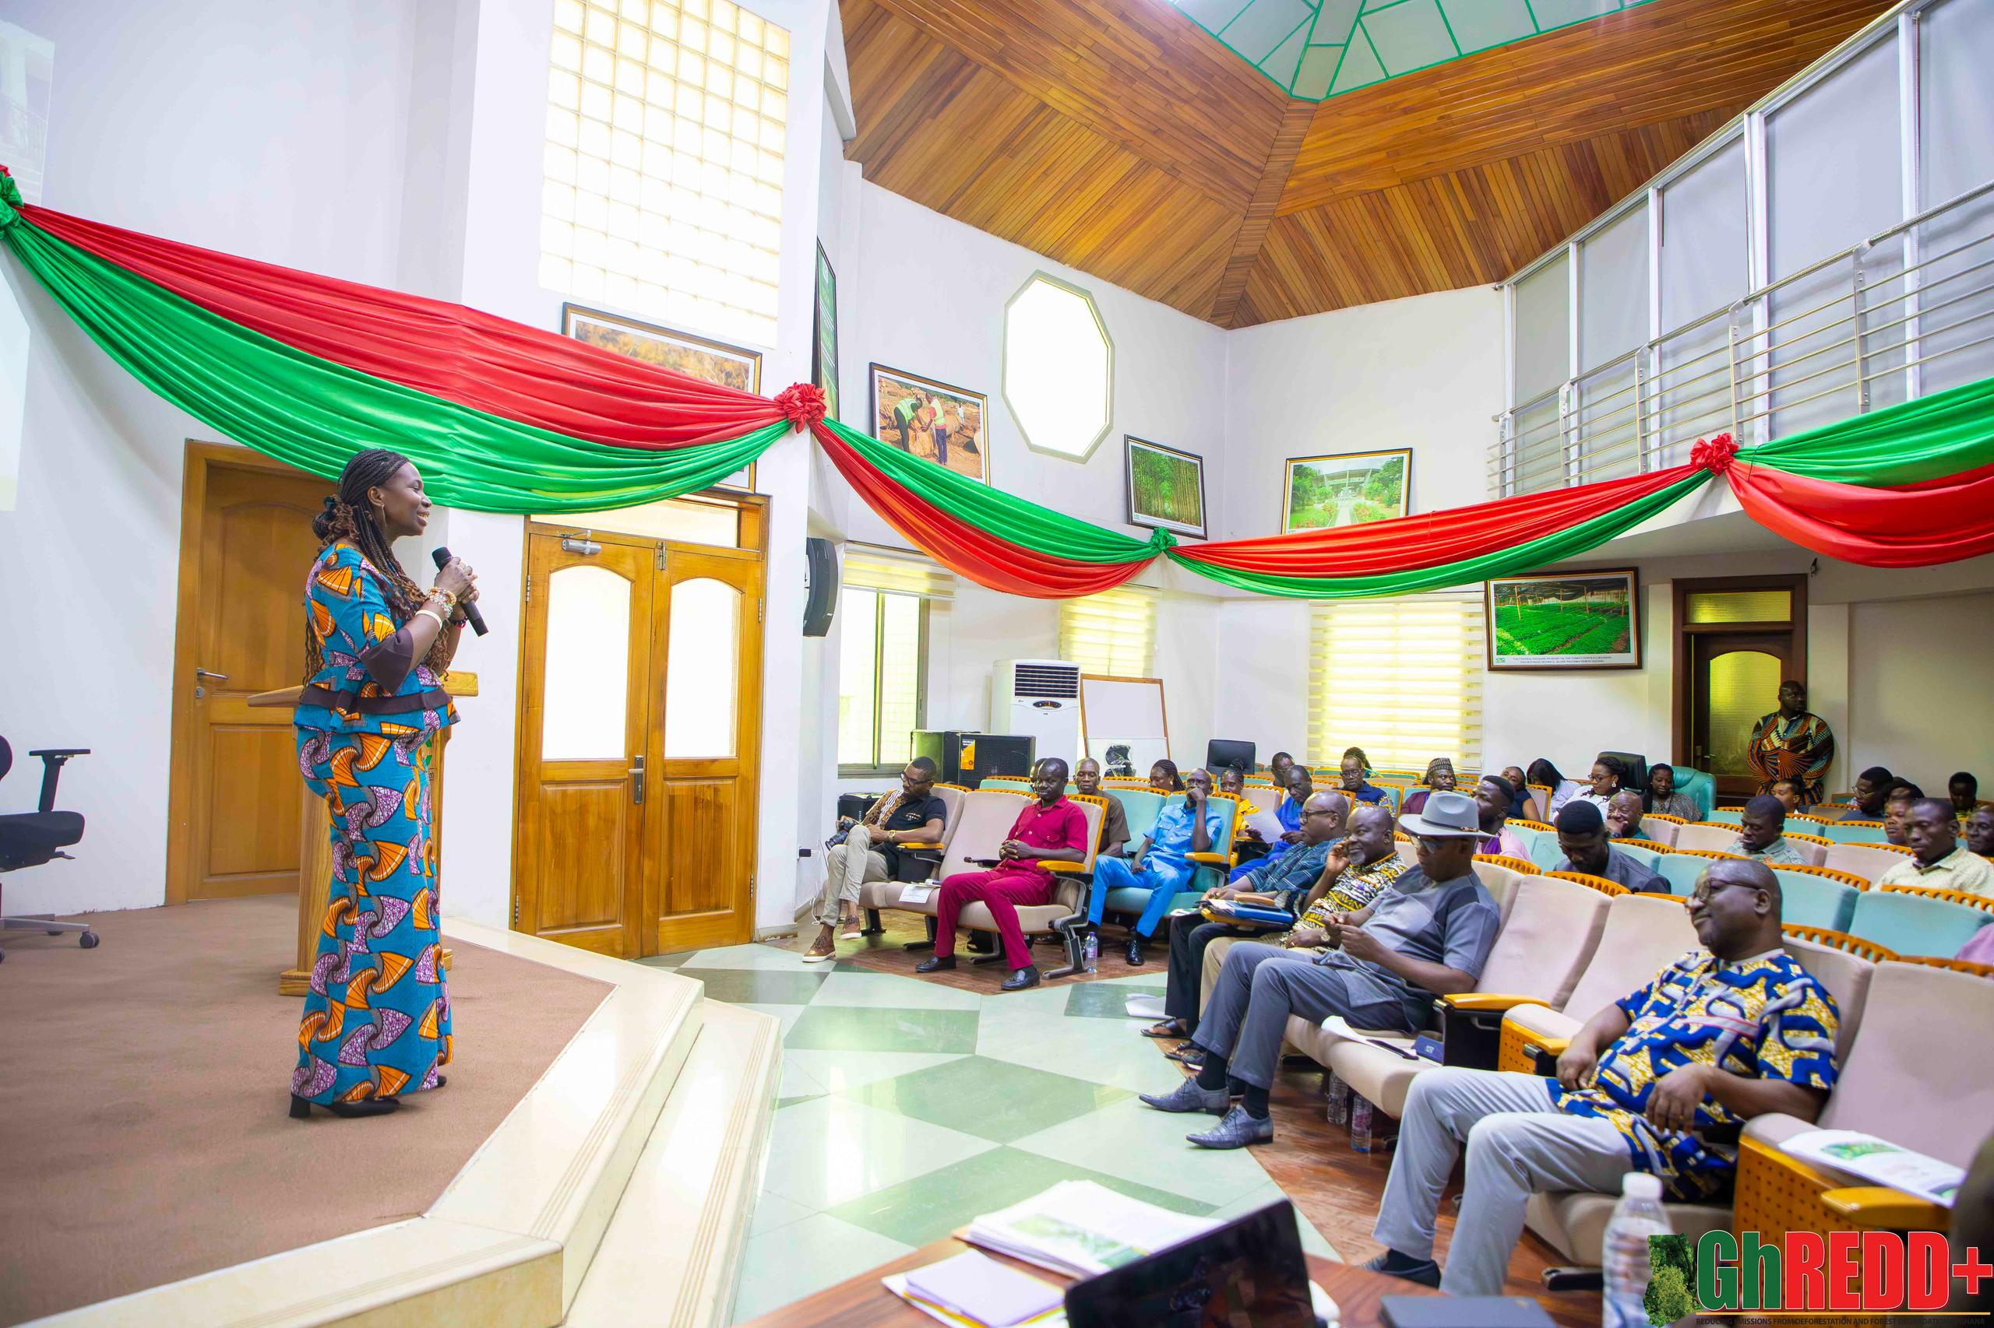
Institutional Arrangements
The implementation framework is designed for coordination, decentralization, and inclusivity.
• Coordination Lead: The process is coordinated by the National REDD+ Secretariat (NRS), housed within the Forestry Commission’s Climate Change Unit (CCU).
• Core Principle: The structure emphasizes decentralization and inclusive involvement of key stakeholders.
• Key Stakeholders: The framework involves relevant Government Agencies (like the Forestry Commission and COCOBOD), the Private Sector, Civil Society Organizations (CSOs), and crucially, Communities and Traditional Councils

Slide 7
A Case Study of the Ghana Cocoa Forest REDD+ Programme
(GCFRP)

Slide 8
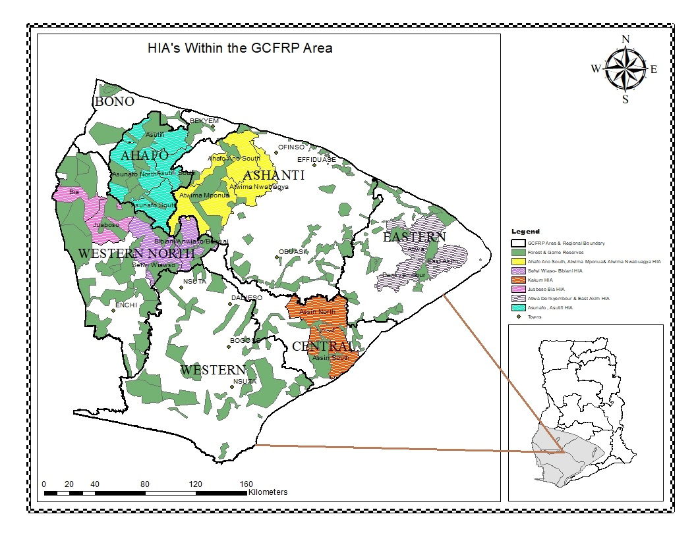
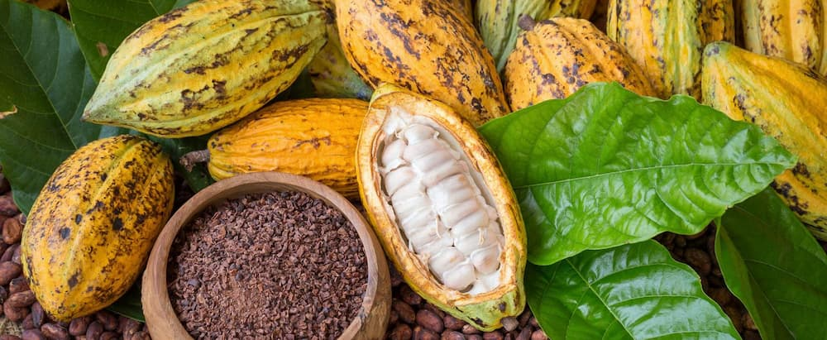

Ghana Cocoa Forest REDD+ Programme
Programme coordinated jointly by the Forestry Commission and the Ghana Cocoa Board
Improve land-use and socio-economic development in the High Forest Zone (HFZ) and Cocoa growing areas of Ghana by increasing cocoa yield on farmlands through intensification with climate smart practices whilst preventing the expansion of cocoa farms into forest lands.
GCFRP-which has carbon emission reduction potential of 10 m tCO2e for the first 6 years and 294m tCO2e over 20 years.
L
Map of GCFRP
Ghana is expected to produce 4 main reports as follows;
1st Monitoring Report (2019)
2nd Monitoring Report (2020/2021)
3rd Monitoring Report (2022/2023)
4th Monitoring Report (2024)
USD50M as payments from results-based Emission Reductions- ERPA with the World Bank’s Forest Carbon Partnership Facility
8

Slide 9
Pillars of GCFRP
B. Institutional Coordination & MRV
Functional JCC
Operations of PMU
Est. CSC consortiums for HIAs
D. Implement CSC to increase yields & sustainability
E. Risk Management & Finance
F. Legislative & Policy Reforms
Monitor activities/MRV/ Data mgt
C. Landscape Planning within HIA areas
Law enforcement
Create CSC HIAs
Complete HIA landscape mgt plans
Implement HIA landscape mgt plans
CSC landscape validation in HIAs
Create CSC good practices guidelines
CSC engagement package in HIAs
HIA CSC consortium implement with farmers
Increase transparency in cocoa purchases
Access to financial credit for CSC
Access to yield insurance
Marketing additional ERs above FCPF
Branding ER Cocoa/Est. Gh CSC Standard
Sustainable finance of HIAs
Passage of legislation on tree tenure etc.
Reform and implementation of gov’t policies
Revise input supply policy
A. Forest Reserve Rehabilitation and Restoration
Enrichment planting
Modified taungya system
Assisted natural regeneration
Job creation

Slide 10
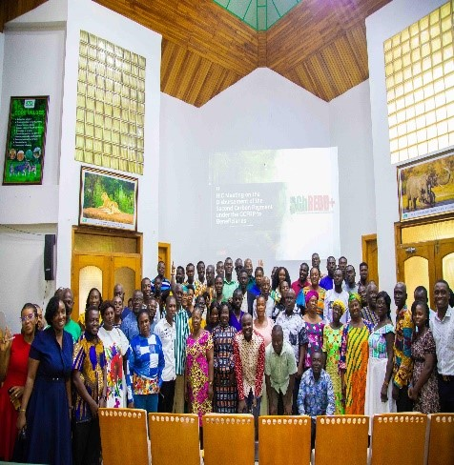
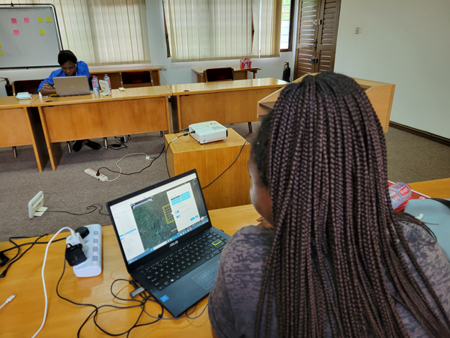
Instruments
Institutional framework and coordination mechanisms for effective REDD+ implementation.
Governance: Decentralization and Inclusive involvement of communities(HMBs, HICs), CSOs, private sector, and all relevant actors.
MRV (Measurement, Reporting & Verification): System to track forest emissions, report progress, and verify emission reductions.
Safeguards: Measures to prevent harm and ensure REDD+ respects environmental and social standards. It also involves taking feedback and grievances.
Benefit Sharing: Fair and transparent distribution of REDD+ revenues to communities and stakeholders. Ghana has developed a Benefit-Sharing Plan.

Slide 11
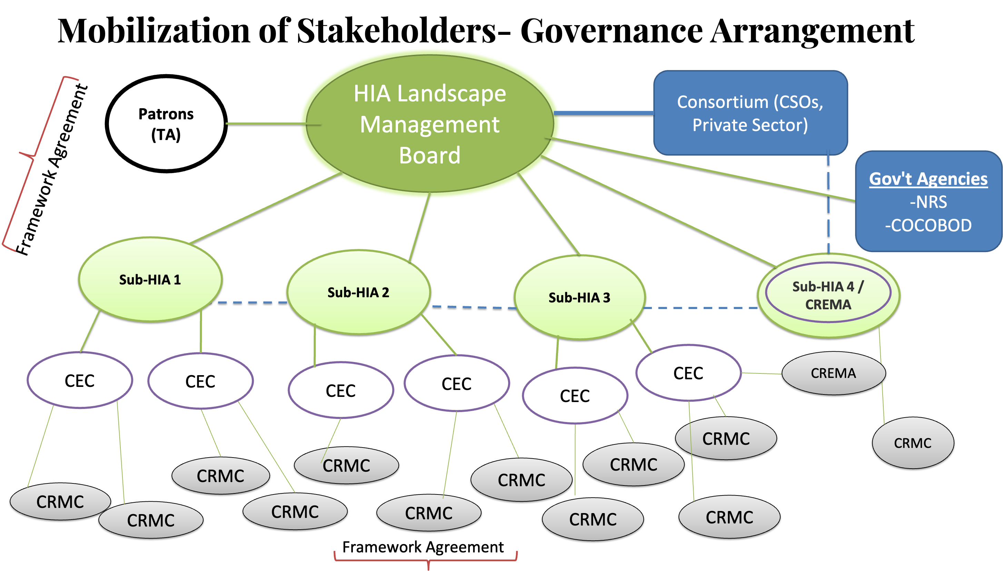
Community Governance Arrangement

Slide 12
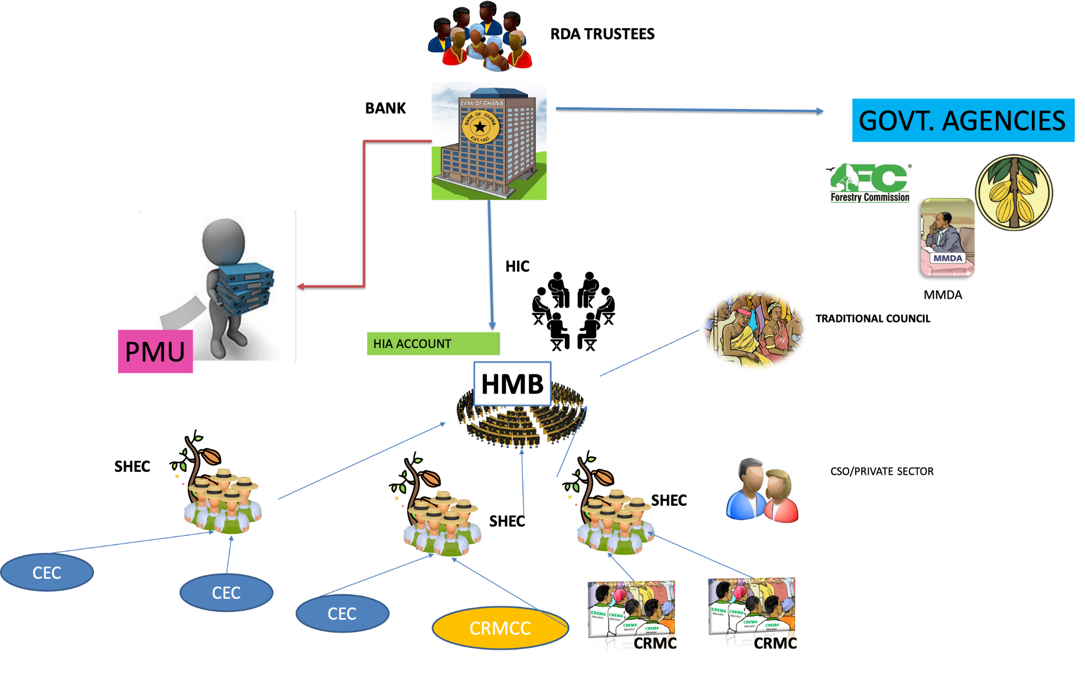
Fund-flow Mechanism For Carbon Payments

Slide 13
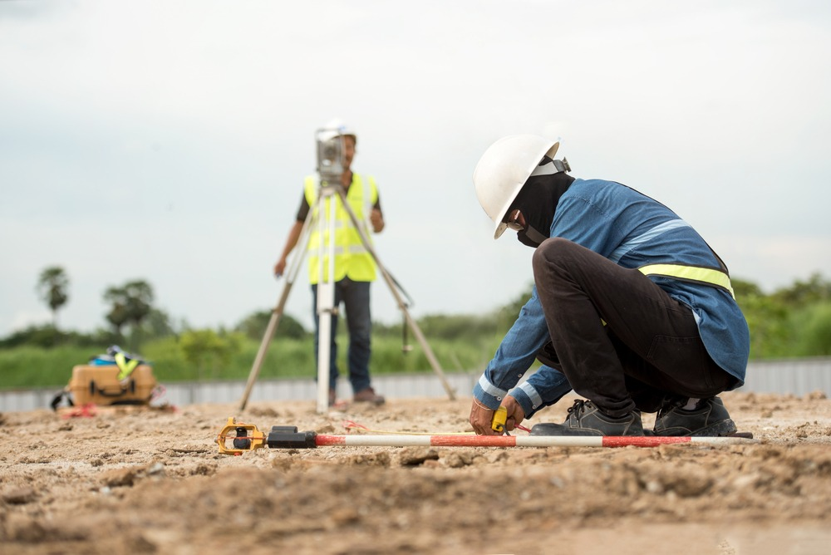
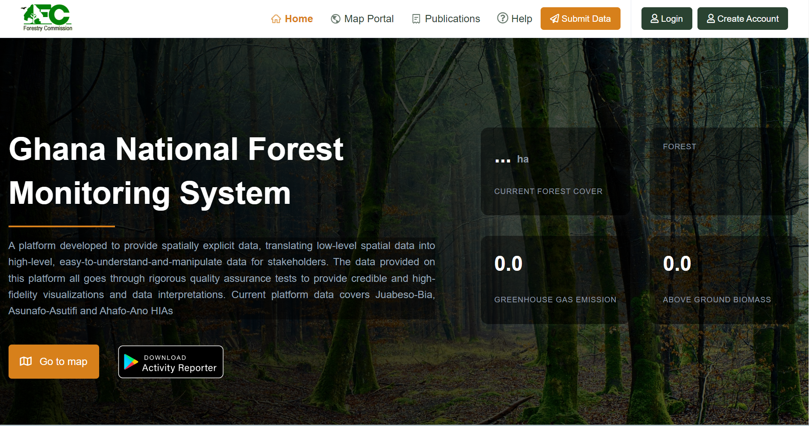
MRV (Measurement, Reporting & Verification)
Measurement, Reporting, and Verification (MRV)
The MRV system is essential for performance-based finance. Ghana has:
• Deployed a National Forest Monitoring System (NFMS) platform, which is the technical foundation used to track forest emissions and determine the Forest Reference Level.

Slide 14
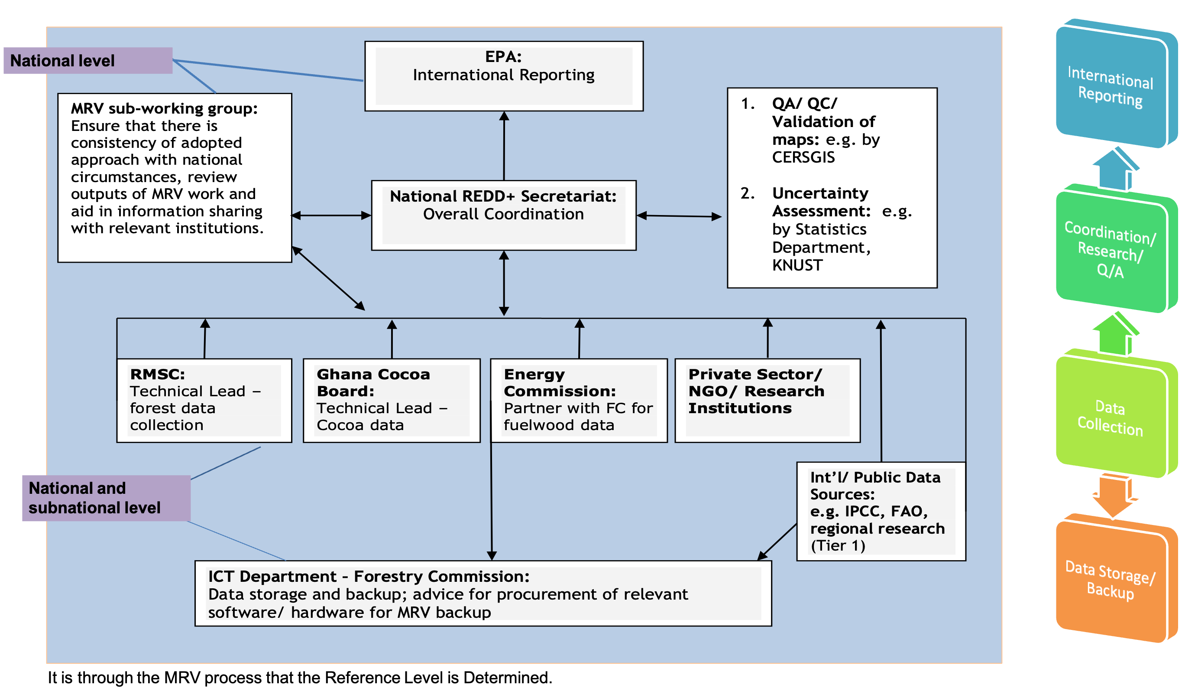
REDD+ MRV Institutional Framework

Slide 15

Safeguards
Safeguards & Transparency
Ghana has established systems to ensure environmental and social standards:
• Safeguards Information System (SIS): Ensures that REDD+ activities comply with global environmental and social standards.

Slide 16
Institutional Setup And Responsibility For Environmental And
Social Safeguards Implementation
REDD+ Safeguards Sub-working Group
REDD+ Secretariat/National Safeguards Focal Person
National EPA, COCOBOD, MoFA, WRC
Regional FSD & WD/ Regional Safeguards Focal Persons
Regional EPA
National level
Private Sector, NGOs/ CSOs
District FSD & WD/ District Safeguards Focal Persons
District Assemblies
Farmers, local communities, plantation growers, landowners, participating individuals/groups
Sub-national level

Slide 17
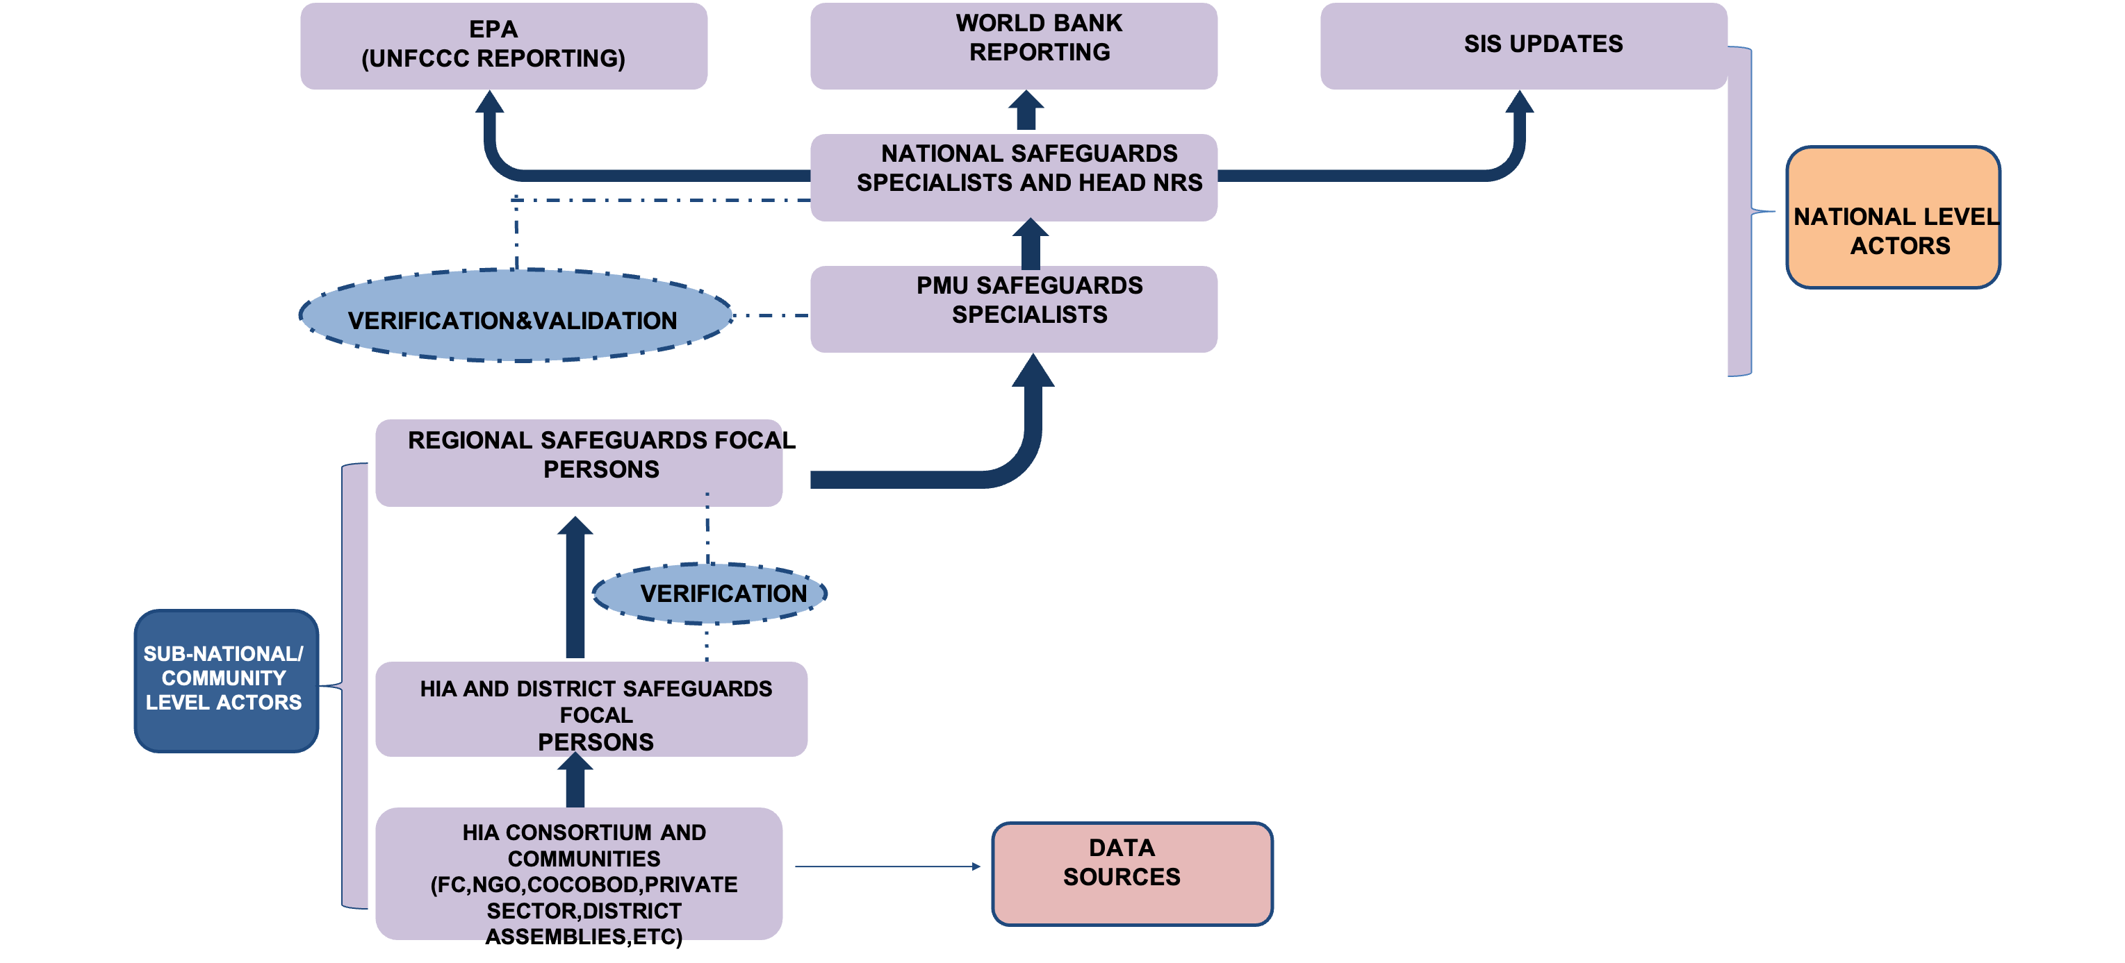
Ghana’s Safeguards Reporting Structure

Slide 18
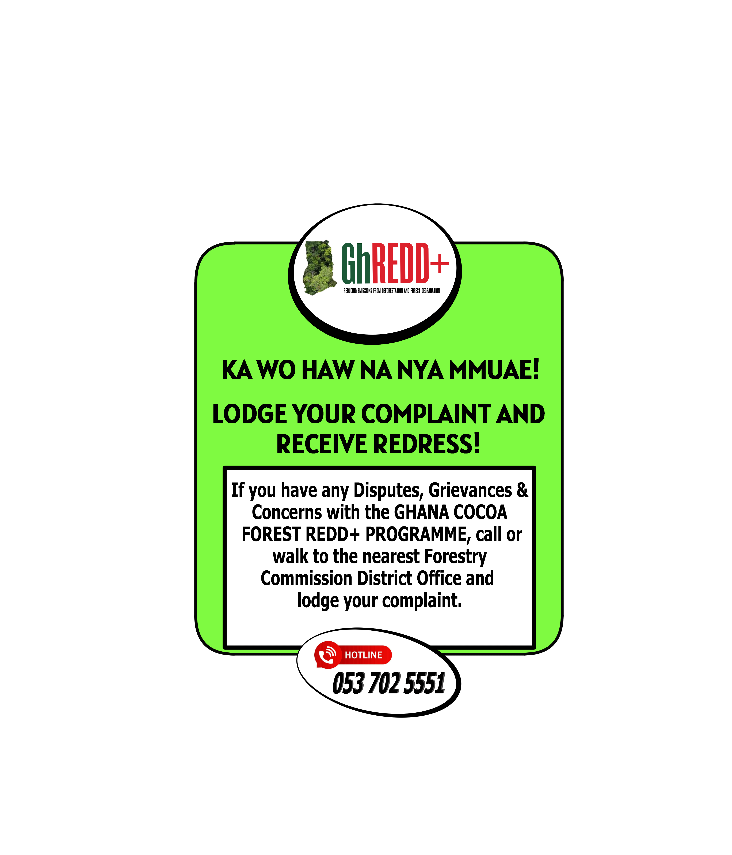
Feedback And Grievance Redress Mechanism (FGRM)
Ghana has established a Feedback and Grievance Redress Mechanism (FGRM) for receiving, evaluating, and addressing project-related grievances from affected communities or stakeholders at the community or project level, region, or country.
Potential conflict sources are;
Resource use and access
Land and tree tenure
Benefit Sharing
Participation and inclusiveness, among others.
As part of the operationalization of the FGRM, awareness creation and sensitization on its modalities are essential. These materials are distributed to partner institutions and communities within the HIAs. They are showcased through posters and will subsequently be made available on T-shirts, and other physical mediums, as well as made available digitally on various platforms to ensure widespread access and engagement.

Slide 19
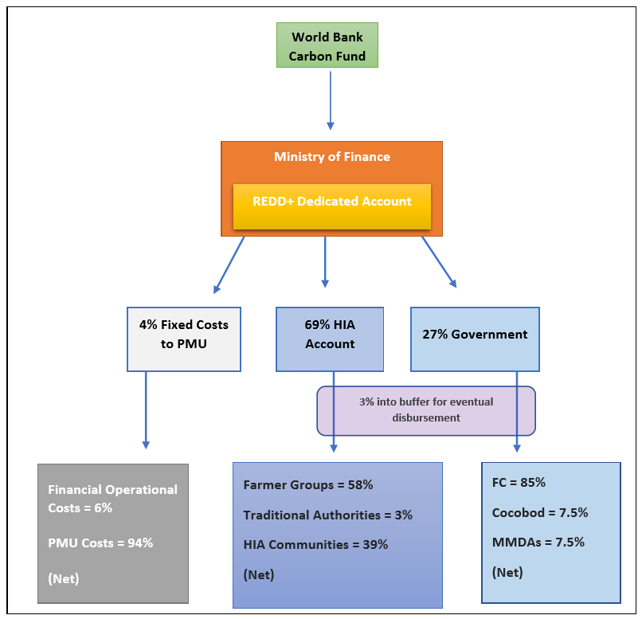
Benefit-Sharing and Fund-flow Mechanism
GCFRP has successfully received first and second ER payments.
First payment- USD 4,862,280 (for 972,465 tonnes of carbon dioxide equivalent at $5/ton
Second payment- USD 16,895,805 (for 3,379,161 tonnes of carbon dioxide equivalent at $5/ton).

Slide 20
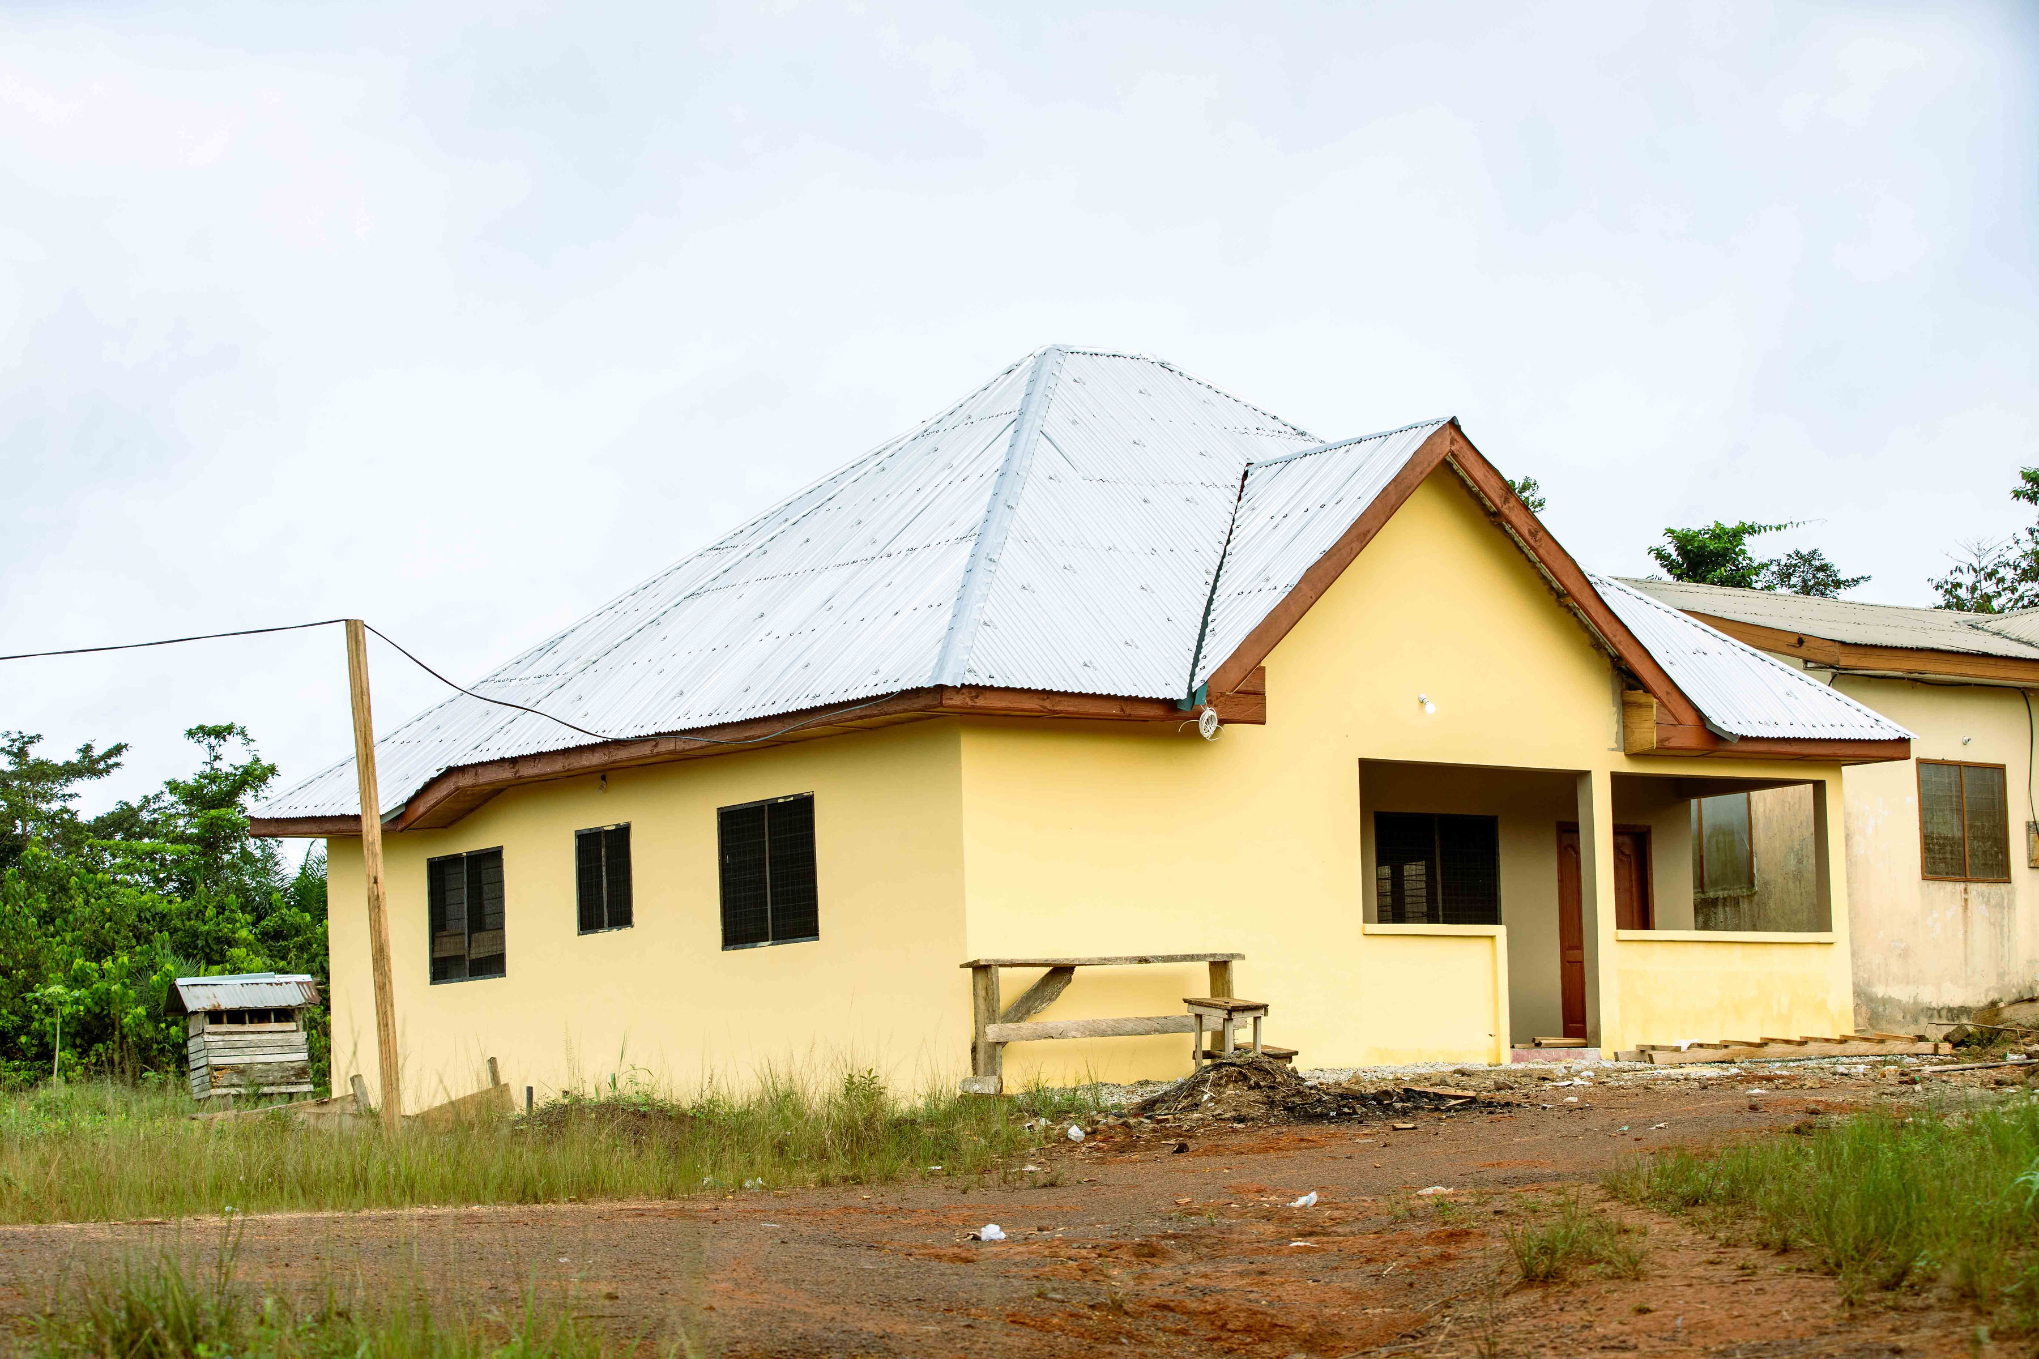
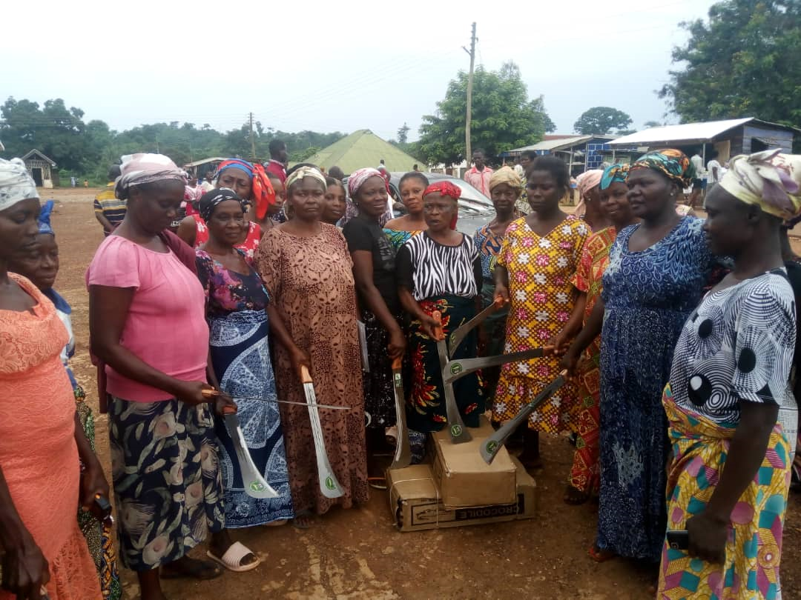
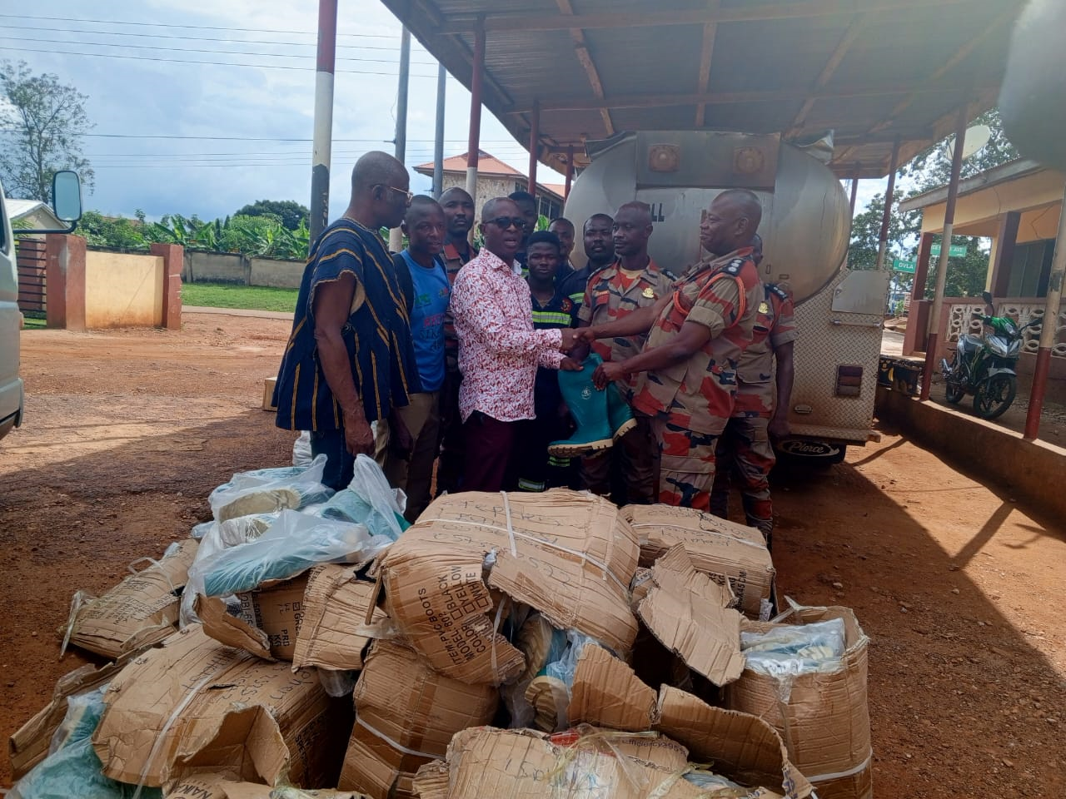
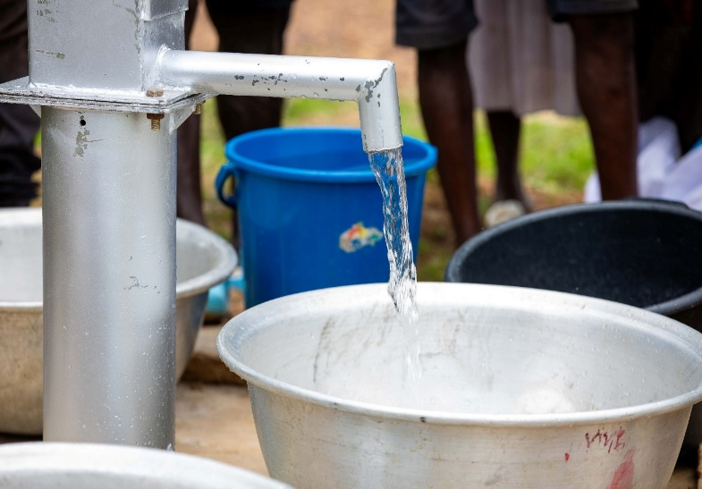
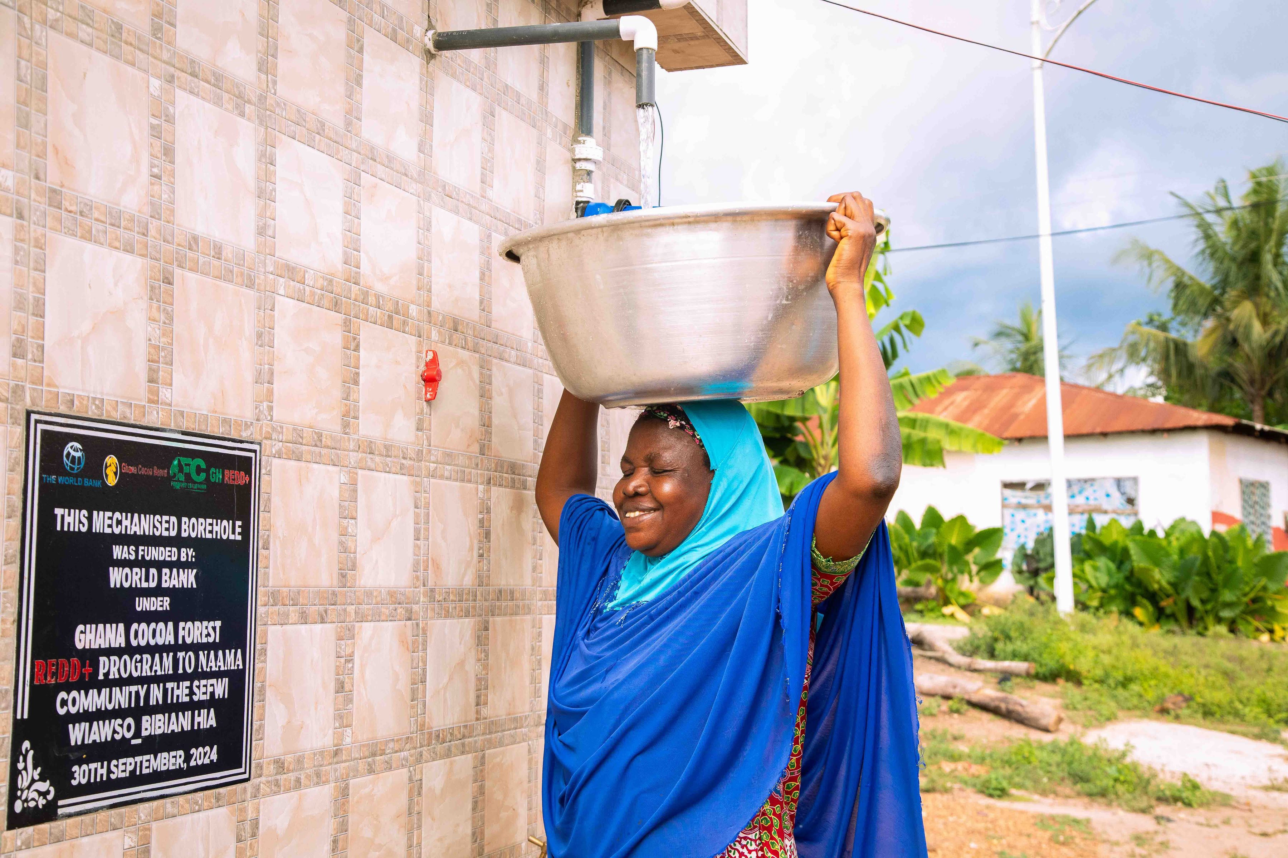
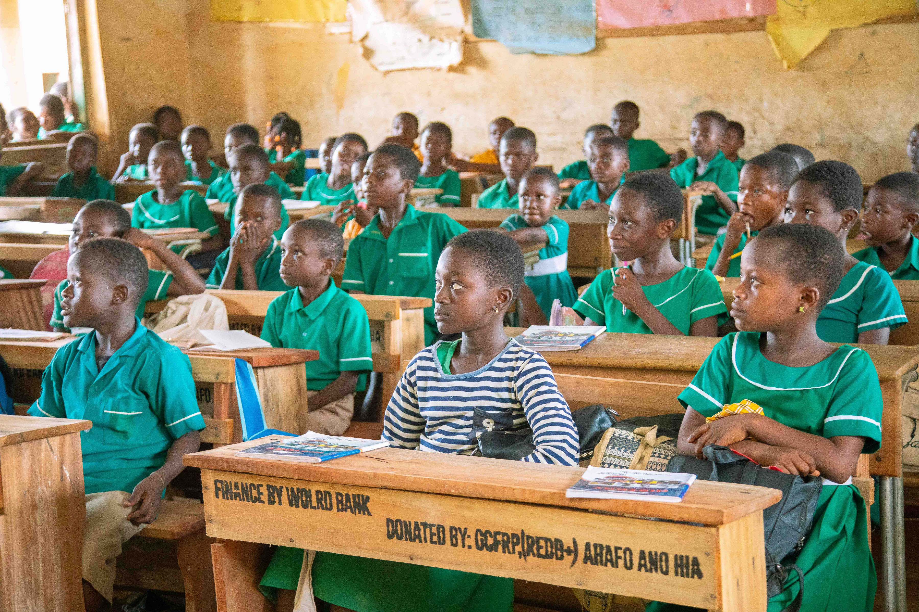
Projects

Slide 21
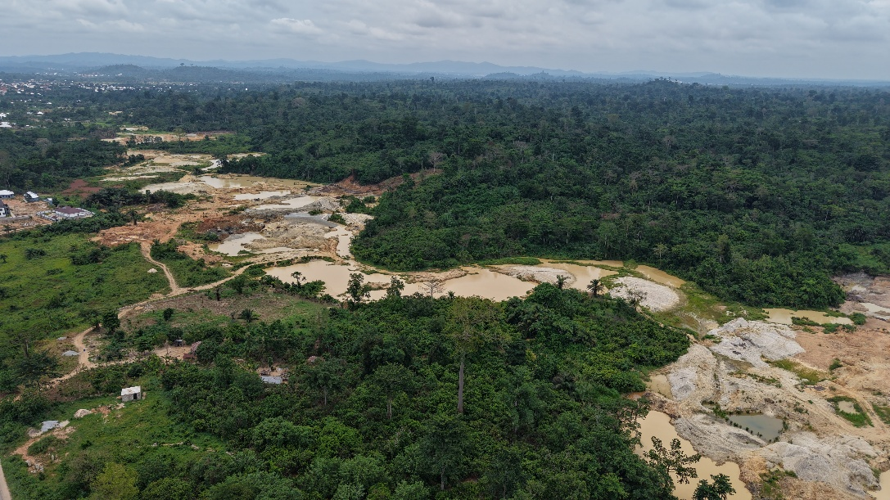
Challenges
• Persistent Threats: Illegal activities, particularly illegal mining (galamsey)
• No robust legal structure to guide nested projects within jurisdictional programs
Communities rely heavily on government support to negotiate fair terms but lack technical and financial benchmarks to do so effectively.
MRV systems still face challenges in consistent data collection, validation, and reporting across regions.

Slide 22
Lessons Learned
Clear landscape vision (what you want to and achieve, how do we do it, what are the various interests that exist, who are the interest groups/stakeholders, what are the common challenges and opportunities).
Clear landscape-specific participatory and inclusive governance arrangement (involve relevant stakeholders in your defined boundaries/ operational areas).
Walk the talk with local communities (implement actions identified through pragmatic phased approach).
Look back, check and adapt (monitor and evaluate defined performance indicators).
Continuous Capacity building and awareness.
Documentation of processes is key.
Strong Leadership (Leadership and expertise drives results).
Global Positioning.
Trust.
Turning Challenges into Opportunities.
Communication, Branding and Storytelling.

Slide 23

Future Directions
The focus is now on securing and implementing the next phase of results-based finance.
• Monetizing New Agreements: Awaiting the issuance of ART-TREES credits under the LEAF and other private ERPAs, which will unlock significant financial transfers.
• New Programmes: Implementation of major new projects:
• The "Resilient Ghana Package," aimed at scaling up compliance and voluntary carbon markets and promoting sustainable resource management.

Slide 24

Conclusion
“Ghana’s REDD+ vision is not just about trees—it’s about people, partnerships, and prosperity.”

Slide 25

THANK YOU
Thomas Yaw Gyambrah
Manager, MRV & REDD+ Programs
nanayaw239@yahoo.com

